Slide 1
Allianz Benefit Control℠ Annuity
Positioning, overview and examples
For financial professional use only – not for public distribution.
Product feature and availability may vary by state.
2895434.16
Notes:
Welcome to this training on the Allianz Benefit Control Annuity.

Slide 2
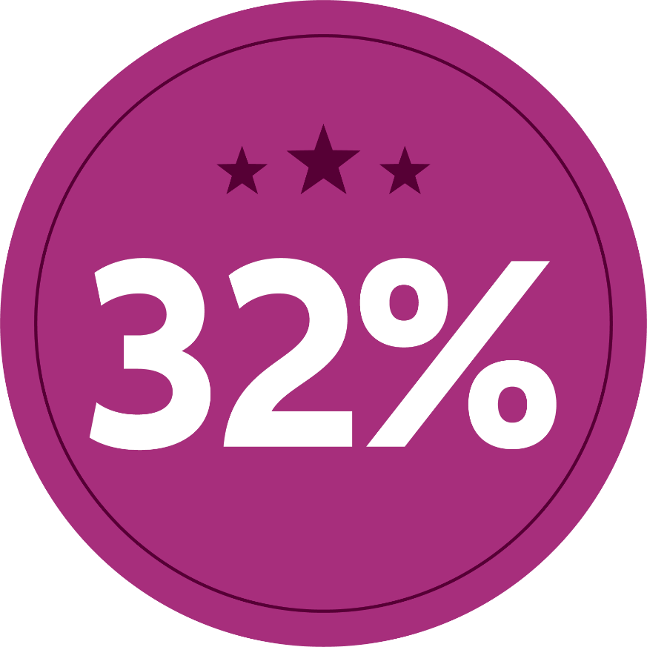
We’ve boosted the premium bonus for a limited time
Premium+ Event
January 31st - April 3rd
The premium bonus is credited to the Protected Income Value (PIV).
Notes:
We’ve boosted the premium bonus for a limited time. Now your clients’ lifetime withdrawal payments can be even bigger with our boosted 32% premium bonus credited to the Protected Income Value (PIV) on the Allianz Benefit Control Annuity. It’s our biggest bonus ever – but it’s only available until April 3, 2023.

Slide 3
Allianz Benefit Control Annuity
Anytime Income
Flexibility to start income withdrawals on any monthiversary*
Benefit Control
Choice between Balanced or Accelerated PIV Interest Bonus
Cost of living
Help address rising costs with increasing income and the Income Multiplier Benefit
*Guaranteed lifetime withdrawal benefit can start as early as 50.
Product feature and availability may vary by state.
Notes:
The Allianz Benefit Control Annuity is an FIA that allows your clients to activate lifetime withdrawals anytime through its included no additional fee lifetime withdrawal benefit rider.
(CLICK) To help increase the benefit base faster, the ABC annuity offers your clients a premium bonus plus a choice between two different interest bonus options. Which means every time interest is earned, it will be credited with an interest bonus.
(CLICK) And with the cost of living in retirement potentially increasing due to such things as healthcare, inflation and taxes, the ABC offers the potential for increasing income based on earned interest as well as the income multiplier benefit which can double the clients withdrawal if they become ill (qualifications apply).

Slide 4
Agenda
01 | Allianz Benefit Control review
02 | How to be a Lock Star: An overview of Index lock features and benefits
Product feature and availability may vary by state.
Notes:
In the following sections we will cover the features and benefits of the Allianz Benefit Control annuity, followed by “How to be a lock star… an overview of index lock features and benefits”

Slide 5
There’s opportunity with Fixed Indexed Annuities (FIAs)
Accumulation potential
Tax-deferred growth
Level of protection
Retirement income
Death Benefits
Guarantees are backed by the financial strength and claims-paying ability of the issuing company.
Product feature and availability may vary by state.
Notes:
Allianz fixed index annuities can be a valuable part of a long term plan for retirement income, offering a level of certainty through many benefits which include:
Accumulation potential
Tax-deferred growth potential
Principal protection from market downturns
Retirement income
And death benefits for beneficiaries.

Slide 6
Fast facts:
Issue age:
0-80
Marital status:
If marital status changes, eligible person can be changed prior to income election
Guaranteed lifetime withdrawal rider:
Included at no cost
Minimum premium:
$20,000 Qualified/Nonqualified
Protected Income Value bonus:
Applied to Protected Income Value only, current rates www.allianzlife.com
Interest Bonus options:
Balanced PIV Interest Bonus Option
Accelerated PIV Interest Bonus Option
Free withdrawals:
10% of total premium paid annually
Flexible premium:
18 months
Market Value Adjustment:
Withdrawals in excess of free withdrawal provision are subject to MVA during withdrawal charge period
Death Benefit:
Accumulation Value (AV): Greatest of AV, GMV or Cumulative Withdrawal Amount
Protected Income Value: Lesser of value at death or 250% of AV
Allocation charge:
Select index allocations include allocation charge
Withdrawal charge schedule:
10 years
Product feature and availability may vary by state.
Notes:
Let’s cover some product details:
The issue ages for ABC are 0-80 years old.
The minimum premium to start the contract is $20,000 qualified or nonqualified.
10% of the total premium paid annually is allowed in a free withdrawal. The free withdrawal is available after the contract anniversary following the most recent premium payment.
Clients are allowed to add premium for the first 18 months.
Select index allocations will have an allocation charge, which will only come into play in extreme market environments.
(CLICK) If the contract owners marital status changes, the new eligible person can be changed prior to income election.
The Protected Income Value (the value income payments will be based on) is credited with a premium bonus after the contract is issued. For current rates please visit our rate page after logging into the allianzlife.com website.
If withdrawals exceed the free withdrawal provision they will be subject to withdrawal charge and Market Value Adjustment during the withdrawal charge period.
The withdrawal charge period is 10 years.
(CLICK) The ABC has a built in guaranteed lifetime withdrawal benefit, which is included at no cost.
The client will have the option of two different PIV interest bonus options. The Balanced or Accelerated Interest Bonus. For current rates please see the rate page at allianzlife.com.
The death benefit, during the Accumulation phase, will be the greatest of the Accumulation Value, Guaranteed Minimum Value or Cumulative Withdrawal Amount, if taken in a lump sum, or the lesser of the Protected Income Value at death or 250% of the Accumulation Value if paid out over a minimum of 5 years. (We’ll look at an example of this at the end of the presentation).

Slide 7
TWO BONUSES to help grow the Protected Income Value (PIV)
What is the Protected Income Value (PIV)?
Premium Bonus
Interest Bonus
Value lifetime withdrawals will be based
NOT available as a lump sum
Applied immediately¹
Applied at end of crediting period
Can be paid as death benefit over 5 year minimum
¹Both the premium bonus and interest bonus are credited only to the Protected Income Value (PIV). To receive the PIV, including the value of these bonuses, lifetime withdrawals must be taken. The PIV is not available as a lump sum. You will not receive these bonuses if the contract is fully surrendered or if traditional annuitization payments are taken. If it is partially surrendered the PIV will be reduced proportionally, which could result in a partial loss of bonuses. Lifetime withdrawals are considered partial withdrawals and are subject to ordinary income tax and, if taken prior to 59½, a 10% federal additional tax. Because this is a bonus annuity, it may include higher surrender charges, longer surrender charge periods, lower caps, higher spreads, or other restrictions that are not included in similar annuities that don't offer a bonus feature.
For financial professional use only – not for public distribution.
Product feature and availability may vary by state.
Notes:
There are 2 bonuses to help grow the Protected income value. (CLICK) A premium bonus which will be applied immediately to the PIV and to all premium paid into the contract and the interest rate bonus which will be applied at the end of each crediting period.
(CLICK) The Protected Income Value is the value in the contract on which lifetime withdrawals will be based. This value is not available as a lump sum. Beneficiaries have access to this value if paid as a death benefit over a minimum 5 years.

Slide 8
Interest bonus options
Bonus Control Benefit Option details:
Balanced
PIV interest bonus
Accelerated PIV interest bonus
Choose a bonus option at time of application and can change on any subsequent crediting period
OR
100% has to be allocated to Balanced or 100% Accelerated for each crediting period
PIV Interest Bonus
PIV Interest Bonus
AV Interest Factor
250%
150%
100%
AV Interest Factor
Rates are set at issue and guaranteed for life of contract
50%
Product feature and availability may vary by state.
Notes:
Each crediting period the contract owner will have the option to choose between the Balanced or Accelerated Interest Bonus option. The balanced PIV interest bonus option credits 150% of earned interest to the PIV and 100% of the credit to the AV.
(CLICK) The Accelerated PIV interest bonus option credits 250% of earned interest to the PIV and 50% to the AV. The client can choose the bonus option at the time of application and can change it on any subsequent contract anniversary however 100% has to be allocated to either the Balanced or Accelerated option per crediting period. Rates are set at issue and guaranteed for the life of the contract.
Next we’ll look at an example of the bonus at work.

Slide 9
Balanced vs. Accelerated interest credit hypothetical example
Balanced
Accelerated
Accumulation Value
Protected Income Value
Accumulation Value
Protected Income Value
Value
$100,000
$132,000
Value
$100,000
$132,000
Index credit
4%
4%
Index credit
4%
4%
Interest factor/bonus
x 100%
x 150%
Interest factor/bonus
x 50%
x 250%
New credit
4%
6%
New credit
2%
10%
Total
$103,050
$139,920
Total
$101,050
$145,200
This hypothetical example is for illustrative purposes only, and is no guarantee of return or future performance, and does not depict the actual performance of the specific product. This example does not assume an allocation charge.
Product feature and availability may vary by state.
Notes:
In this hypothetical example the contract owner has started the contract with $100,000 and has allocated 100% to the Balanced PIV Interest Bonus option. The protected income value will receive a premium bonus immediately. At the end of the first crediting period the index interest is [4%]. The AV will receive 100% of the [4%] indexed interest and the PIV will receive [150%] of the indexed interest equaling [6%]. From here you can see the new values in the Accumulation and Protected Income Values.
(CLICK) In our Accelerated option the AV and PIV start off the same as the balanced. The indexed interest is [4%] at the end of the crediting period however with the Accelerated option the AV interest factor is [50%] and the PIV interest bonus is [250%]. The indexed credit will then equal [2%] in the AV and [10%] in the PIV. The Protected Income Value ends up much higher than the Accumulation Value as it is geared toward clients looking to take lifetime withdrawals.

Slide 10
Which option is better for your client?
Accelerated Option
Interest earned | 4.0% | 0.0% | 2.0% | 3.0% | 4.5% | 1.5% | 0.0%
PIV Credit | 10.0% | 0.0% | 5.0% | 7.5% | 11.3% | 3.8% | 0.0%
PIV | $145,200 | $145,200 | $152,460 | $163,895 | $182,333 | $189,170 | $189,170
AV Credit | 2.0% | 0.0% | 1.0% | 1.5% | 2.25% | 0.75% | 0.0%
Accumulation Value | $101,050 | $100,090 | $100,140 | $100,691 | $102,000 | $101,796 | $100,829
$189,170
$100,829
ENHANCE OPPORTUNITY for income
$164,386
Balanced Option
Interest earned | 4.0% | 0.0% | 2.0% | 3.0% | 4.5% | 1.5% | 0.0%
PIV Credit | 6.0% | 0.0% | 3.0% | 4.5% | 6.75% | 2.25% | 0.0%
PIV | $139,920 | $139,920 | $144,118 | $150,603 | $160,769 | $164,386 | $164,386
AV Credit | 4.0% | 0.0% | 2.0% | 3.0% | 4.5% | 1.5% | 0.0%
Accumulation Value | $103,050 | $102,071 | $103,143 | $105,257 | $108,994 | $109,593 | $108,552
BALANCE
of income and accumulation
$108,552
Assumption: Starting premium $100,000 with premium bonus 32%
This hypothetical example is used to show how the product features work and assumes a premium bonus. The interest credits used are hypothetical and not meant to represent an actual product nor meant to guarantee results.
Product feature and availability may vary by state.
Notes:
Over time you can see the accelerated option is better for clients looking to (CLICK) enhance their opportunity for income and the Balanced for those who want more of a (CLICK) income/accumulation balance.
Most of the topics covered this far pertain to the Accumulation phase. Now let’s switch over and talk about the distribution phase.

Slide 11
Increasing income
Current payout rates
Age Bands | Single Payout % | Joint payout %
50-54 | 3.00% | 2.50%
55-59 | 3.50% | 3.00%
60-69 | 4.00% | 3.50%
70-79 | 4.50% | 4.00%
80+ | 5.00% | 4.50%
+ 150% Balanced interest bonus
INTEREST + 150% BONUS
INDEX INTEREST
LIFETIME WITHDRAWAL
Illustrating the Balanced option which is automatically selected during income
4.5%
7.5%
6%
3%
5%
4%
No change
Income anytime
No change
$11,908
$11,908
$11,234
$10,000
$10,450
$10,450
Year 6
Year 7
Year 8
Year 9
Year 10
Product feature and availability may vary by state.
Notes:
Once your client is ready to turn income on their 1st lifetime withdrawal will be based on what the protected income value has grown to. Once lifetime withdrawals are activated, your clients payment has the opportunity to increase every year interest is earned (CLICK) + 150% interest bonus. The opportunity for your clients income to increase can help address rising cost during retirement.
In this hypothetical example you can see the starting lifetime withdrawal is $10,000. Every year interest is credited the withdrawal increases by the same percentage plus the interest bonus. Withdrawals always have the potential to increase but will never decrease due to market volatility.

Slide 12
Increasing income over life expectancy
Initial premium: $300,000
Income start year: 7
Average return: 3%
Bonus option during accumulation: Accelerated (250%)
Bonus during distribution: Balanced (150%)
PIV value year 7: $607,212
Withdrawal rate: 4%
$68,364
$26,279
Hypothetical example assuming life expectancy of 65 yr old female
Notes:
This chart shows the increasing income opportunity over the average life expectancy of a 65 year old female. During the accumulation phase we are assuming 3% average rate of return plus the 250% accelerated interest bonus and during distribution a 3% average rate of return plus 150% balanced interest bonus. As you can see the initial lifetime withdrawal has more than doubled by the time the client has turned 87.
https://www.ssa.gov/cgi-bin/longevity.cgi

Slide 13
Income Multiplier Benefit
Clients can withdrawal up to DOUBLE the lifetime income if EITHER:
Confined to nursing home, LTC facility, hospital or assisted living
OR
Unable to perform 2:6 activities of daily living
*Eligibility available after 5 year wait period
Confinement and ADL certification must occur after the first contract year and either during the contract year before the start of lifetime income withdrawals or at any time thereafter. To receive the Allianz Income Multiplier Benefit, the contract owner must be confined to an eligible hospital, nursing facility, or assisted living facility for at least 90 days in a consecutive 120-day period or unable to perform at least two of six activities of daily living (bathing, continence, dressing, eating, toileting, and transferring) as certified by a physician. The AIM Benefit continues until the accumulation value is zero or the patient recovers, when it will revert back to the standard payout.
$40,000
$41,000
$43,000
Hypothetical example
$21,500
$20,000
Income before illness
Income doubles due to illness
Income increase from index credit
Income increase from index credit
After recovery, income decreases by half
This hypothetical example is for illustrative purposes only, and is not guarantee of return or future performance, and does not depict the actual performance of a specific product. Rider availability may vary by state.
Product feature and availability may vary by state.
Notes:
In addition to increasing income, the Allianz Income Multiplier Benefit is the another way to help alleviate some of the rising cost during retirement. This benefit allows clients to double their income by qualifying one of two ways. If the contract owner is confined to a qualified nursing home, long term care facility, hospital or assisted living facility for at least 90 days in a consecutive 120 days (after the first year) or if the client is unable to perform 2:6 Activities of Daily Living for 90 consecutive days they would qualify.
(CLICK) In our hypothetical example, the withdrawal prior to the illness is $20,000. After meeting the criteria, the payment doubles to $40,000. And as you can see still has the opportunity to increase due to indexed interest being credited to the contract.
This benefit continues until either the client recovers or the accumulation value reaches zero, upon which the payments revert back to the standard payout.
Please note: A physician must certify the covered person is unable to perform (without direct physical assistance of another person) at least 2:6 ADLS for at least 90 continuous days.

Slide 14
A variety of allocation options
 |  |  |  |  | ALLOCATION CHARGE APPLIES¹
 | MONTHLY SUM | ANNUAL POINT-TO-POINT |  |  | MY POINT-TO-POINT¹
 |  |  |  |  | 2-YEAR | 5-YEAR
S&P 500® Index | Cap | Cap
Bloomberg US Dynamic Balance Index II |  | Cap | Spread
PIMCO Tactical Balanced Index |  | Cap | Spread
BlackRock iBLD Claria® Index |  | Cap | Spread
Bloomberg US Dynamic Balance II ER Index |  |  |  | Participation rate | Participation rate | Participation rate
PIMCO Tactical Balanced ER Index |  |  |  | Participation rate | Participation rate | Participation rate
BlackRock iBLD Claria® ER Index |  |  |  | Participation rate
S&P 500® Futures Daily Risk Control 5% Index |  |  |  |  | Participation rate | Participation rate
Large-cap index
¹MY point-to-point crediting methods are subject to an allocation charge, deducted annually from the contract’s accumulation value and guaranteed minimum value. The allocation charge percentage can only change when specified triggers are met and can never be greater than the maximum allocation charge percentage of 2.5%. The current allocation charge can be found in the applicable product Guide to Current Rates.
Volatility-controlled index
(stock and bond)
Volatility-controlled
futures index
(stock and bond futures)
Although an external index may affect interest credited, the contract does not directly participate in any equity or fixed income investments. Clients are not buying shares in an index.
NEW
Fixed interest allocation is also available
Notes:
Here is a view of the many index allocation options your clients can choose from to help grow their contract values. Select index allocations might have an allocation charge. Let’s review a few details on this.

Slide 15
PIV Death Benefit hypothetical example
Lesser of Protected Income Value at death or 250% of the Accumulation Value
Hypothetical example 1
Accumulation Value
Protected Income Value
Value at death
100k
225K
Death benefit cap (250% of AV)
Does not apply
Beneficiary payout
100k
225K
Hypothetical example 2
Accumulation Value
Protected Income Value
Value at death
100k
300k
Death benefit cap (250% of AV)
x 250%
Applies
Beneficiary payout
100k
250k
Product feature and availability may vary by state.
Notes:
The PIV death benefit equals the lesser of the Protected Income Value at death or 250% (the death benefit cap) of the Accumulation Value.
Lets look at two different hypothetical examples.
In our first example the client passes and 100k is available in the Accumulation Value and 225k in the Protected Income Value. (CLICK) The death benefit cap would not come into play since the PIV death benefit is less than 250% of the AV death benefit.
(CLICK) In our second example the AV at death is 100k and the PIV is 300k. In this scenario the (CLICK) 250% cap would come into play. (CLICK) Multiply the 250% by the 100k AV to equal the PIV death benefit of (CLICK) 250k. The beneficiary can receive the 100k AV in a lump sum or take the 250k in the PIV over at least 5 years.
This cap can change on new business however once a contract is issued, the value cannot change.

Slide 16
Allianz Benefit Control
Call your Allianz contact today to discuss case design and suitability
Anytime income
Benefit control choices
Cost of living opportunity increases
Product feature and availability may vary by state.
Notes:
In summary, the Allianz Benefit Control can offer your clients income anytime, a premium bonus plus the choice between an accelerated or balanced interest bonus to help grow the Protected Income Value and the opportunity for income to increase to help address rising costs during retirement. Call your Allianz contact today to discuss case design and suitability.
Next lets discuss how YOU can be a LOCK star.. with your clients.

Slide 17
How to be a
LOCK STAR
An overview of Index lock and related features
Product feature and availability may vary by state.
Notes:
This section will cover a high level overview of index lock and its related features.

Slide 18
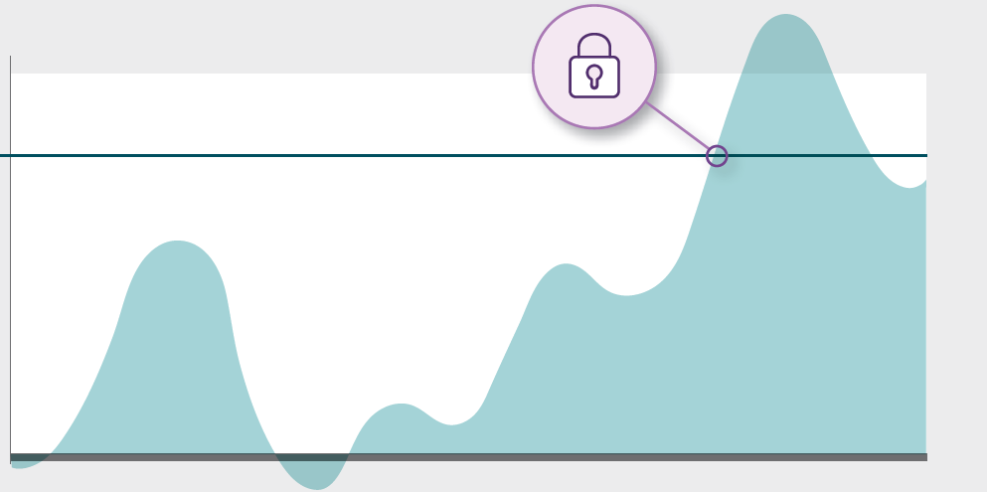
Benefits of Index lock
Track and view index values 24/7 online
Lock in positive index values on select indexed interest allocations anytime during crediting period
Help minimize the effects of mid-term market volatility
The index lock occurs at the end of the business day, therefore the actual value received may be more or less than the value at the time of request. This feature may be discontinued at any time. See www.allianzlife.com for full details and business rules.
Notes:
Allianz allows you to track and view index values 24/7 online. You or your client will be able to lock in positive index values on select indexed allocations anytime during the crediting period. Having the opportunity to index lock can help minimize the effects of min-term market volatility.

Slide 19
WHAT VALUE do our customers typically choose to lock in?
6.3% is the average credit since inception among account values of our FIA allocations with an active Index Lock.
NOTE: Results displayed are actual historical index credits applied to the accumulation value. For products with a separate income value, any applicable interest bonus would be applied on top of these results shown. Average locked interest rate for clients who applied the Index Lock feature between September 9, 2019 and November 22, 2022. The total number of contracts used for this analysis was 7,970 and both one-year and two-year crediting methods were included. Potential interest varies by index strategy and index. Past results are not a guarantee of future performance. Exercising an Index Lock may result in a credit higher or lower than if the Index Lock had not been exercised. We will not provide advice or notify you regarding whether you should exercise an Index Lock or the optimal time for doing so.
Notes:
Each customer is different. Goals and objectives will vary. Index Lock and auto lock give you and your client the flexibility and control to determine the appropriate time or the appropriate percentage to lock in.
*From CSI-549

Slide 20
TWO ways to LOCK IN A GAIN on a Fixed Index Annuity (FIA)
Manual Lock
Choose when to lock the index interest rate during a crediting period
Auto Lock*
Set upper and lower targets to activate an index lock automatically
*Auto Lock is available on new business and inforce contracts with Index Lock.
Since the index value locks at the end of the business day, the actual value used to determine your interest credit may be higher or lower than at the time of request. See CSI-504 for full details and business rules.
allianzlife.com/indexlock
Notes:
There are two ways to lock in a gain on an Fixed Index Annuity. Manually or automatically.
The first way, a manual index lock, lets you choose when to lock in the index interest rate by going into the secure site and selecting manual index lock.
The second way, an auto lock, gives you the option to set upper and/or lower targets, also within our secure site. When the targets are reached, it will lock in the desired indexed interest rate percentage automatically.

Slide 21
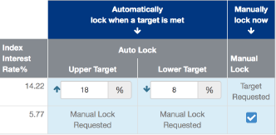
How to initiate a lock
Automatically
lock when a target is met
Manually lock now
Index Interest Rate %
Auto Lock
Auto Lock example
Manual Lock
Upper Target
Lower Target
7.77
%
%
Target
Requested
12
%
7
%
8.90
Manual Lock Requested
Manual Lock Requested
Manual Lock example
Sample website view: Index allocations, crediting period start and end date not shown. Website view subject to change.
Index lock is available on select index allocations. For more information and business rules check out CSI-504 and/or allianzlife.com/indexlock
Notes:
Initiating an index lock is easy. On the slide is a sample view of what you would see on the website. For auto lock you see the index interest rate percentage is at 7.77%. We have set an upper target at 12% and lower target at 7%. You are free to adjust the target index interest rate percentage – either up or down – as many times as you wish, as long as Auto Lock hasn’t been activated during that crediting period and your upper target is greater (or lower target is less than) the current index interest rate percentage. The targets will be effective immediately although changes may not reflect on the website for 1-2 days. If you would like to request a manual lock after targets have been set, clear out the upper and lower target fields and the manual lock option box will reappear. Once an indexed allocation is locked it will show locked with the locked rate and the date of the lock.
In our manual lock example no targets were set. The index interest rate percentage is at 8.90%, so a request is made to lock in that rate. After selecting the box on the right, the view will change to say “Manual Lock Requested”.

Slide 22
How to lock in a Multi-year strategy
+
MY point-to-point
Lock it in & go again
with participation rate crediting method
on the next contract anniversary
Although Multi-year crediting is designed to offer higher rates than their one-year counterpart, there is no guarantee rates will be higher or that they will increase year over year. Rates will vary due to market conditions.
Notes:
What about index lock in a multi-year crediting method? With our multi-year crediting or My point to point crediting methods your clients can “lock it in” (they credit they want)… and “go again” (receive the credit and start new allocations) on the next contract anniversary….not at the end of the crediting period. With most other FIAs, clients must wait until the end of the crediting period…and leave the credit to chance. Please note: the lock is not guaranteed if the index does not reach a target.
Lets take a look at how this works.

Slide 23
Participation rates… designed to increase
Hypothetical
Available allocation options:
Participation Rates for all Contract Years in a Crediting Period are GUARANTEED for the Crediting Period
2 year point-to-point with par rate
5 year point-to-point with par rate
120%
110%
100%
90%
80%
80%
70%
60%
(Annual example)
Year 1
Year 2
Year 3
Year 4
Year 5
*This is a hypothetical example used to explain the MY PtP crediting method concept and does not represent any specific product or index. Although Multi-year crediting is designed to offer higher rates than their one-year counterpart, there is no guarantee rates will be higher or that they will increase year over year. Rates will vary due to market conditions. Refer to the Allianz Guide to Rates for current participation rates.
Notes:
Whether the client chooses the 2-yr or (CLICK) 5-yr period … the guaranteed participation rates are designed to start higher (than annual point to point) … then increase annually throughout the multi-year crediting period. Simply put “The longer you wait … the bigger the par rate”. For example using the 5 year point to point method, if an index lock is activated in crediting period year 2 the client will earn 90% of the index gain. If an index lock is activated in year 5 they will earn 120% of the index gain. The participation rates shown are hypothetical. Please refer to the Allianz guide to rates for current participation rates.
Participation rates for all contract years in a crediting period are declared at issue at the beginning of each new crediting period and are guaranteed for the crediting period. Renewal rates may be the same as the previous schedule or different.
Lets look at an example.

Slide 24
This example is for illustrative purposes to show how MY crediting and index lock works. It does not represent an actual contract or a guarantee of future results.
LOCK IT IN & GO AGAIN
Hypothetical example
Please note: index lock can only be activated on index returns greater than zero.
FIRST 5-YEAR CREDITING PERIOD
NEW 2-YEAR CREDITING PERIOD
NEW 5-YEAR crediting period
10%
Index value increase
132
100%
Participation rate
Down market example
10%
Index credit
0.00%
Index credit
Index Value
25%
Index value increase
112
110%
Participation rate
110
106
28%
Index credit
LOCK
LOCK
[Par rates]
Cred. Period
Year 1
90%
Cred. Period
Year 2
100%
Cred. Period
Year 1
70%
Cred. Period
Year 2
80%
Cred. Period
Year 1
85%
Cred. Period Year 3
Cred. Period
Year 2
95%
Cred. Period
Year 3
105%
Cred. Period
Year 4
110%
Contract anniversary
Contract anniversary
Contract anniversary
Contract anniversary
Notes:
In the first 5 year crediting period our hypothetical clients, Jerry and Lisa initiate an index lock in crediting period year 2. The index gain multiplied by the par rate in year 2 will equal their index credit. The credit will be applied on the contract anniversary after the index lock.
(CLICK) Jerry and Lisa have the option to now pick a new annual, 2 year or 5 year crediting period and decide on a 2 year period. In this example you can see the index value declined so no index lock occurred. They did not gain an index credit but did not lose any value either. Please note: if an allocation charge or other contract fees apply, the contracts value would be reduced by the cost of the fees or the charge.
(CLICK) At the end of the 2 year crediting period, Jerry and Lisa allocate to a new 5 year crediting period. The index value has a steady increase and they activate index lock in crediting period year 4. Please note: Index lock can only be activated on index returns greater than zero.
(CLICK) When setting upper targets with MY point-to-point crediting methods, keep in mind that participation rates increase each year and could activate an index lock immediately on the contract anniversary. Consider setting upper auto lock targets higher than normal.

Slide 25
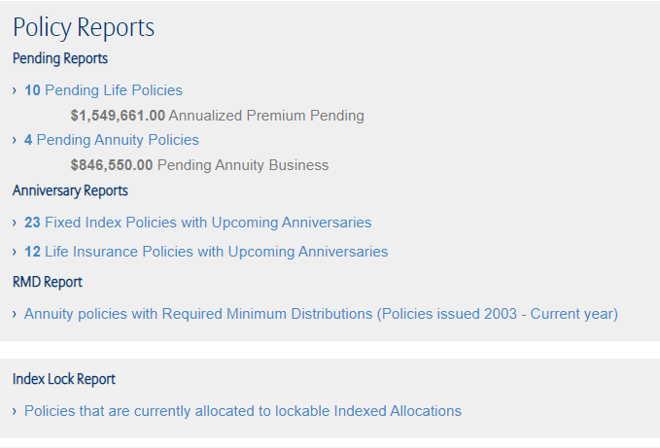
Index Lock report opportunities
%
Filter contracts equal to or above a specific interest rate
Sort contracts from highest to lowest available by interest rate
Select all indexed interest allocations or specify a certain one
allianzlife.com/indexlock
Exercising an Index Lock may result in a credit higher or lower than if the Index Lock had not been exercised. We will not provide advice or notify you regarding whether you should exercise an Index Lock or the optimal time for doing so.
Notes:
Uncover index lock opportunities. Our on-demand Index Lock report (available on the allianzlife.com website) allows you to filter contracts equal to or above a specific interest rate, sort contracts from highest to lowest by interest rate and specify which allocations you want to see. Run a report today and see what indexed interest rates are available to be locked across your entire book of business.

Slide 26
THANK YOU.
Guarantees are backed by the financial strength and claims-paying ability of Allianz Life Insurance Company of North America.
Contract CS64370-MVA, R95581-01-MVA state variations are issued by Allianz Life Insurance Company of North America.
Products are issued by Allianz Life Insurance Company of North America, 5701 Golden Hills Drive, Minneapolis, MN 55416-1297. 800.950.1962 www.allianzlife.com
• Not FDIC insured • May lose value • No bank or credit union guarantee • Not a deposit • Not insured by any federal government agency or NCUA/NCUSIF

Slide 27
Disclosure
The S&P 500® Index is comprised of 500 stocks representing major U.S. industrial sectors.
S&P® is a registered trademark of Standard & Poor’s Financial Services LLC (“S&P”). This trademark has been licensed for use by S&P Dow Jones Indices LLC and its affiliates. S&P® and S&P 500® are trademarks of S&P. These trademarks have been sublicensed for certain purposes by Allianz Life Insurance Company of North America (“Allianz”). The S&P 500 is a product of S&P Dow Jones Indices LLC and/or its affiliates and has been licensed for use by Allianz. Allianz products are not sponsored, endorsed, sold, or promoted by S&P Dow Jones Indices LLC, Dow Jones, S&P, or their respective affiliates and neither S&P Dow Jones Indices LLC, Dow Jones, S&P, or their respective affiliates make any representation regarding the advisability of investing in such product.
The "S&P 500® Futures Daily Risk Control 5% Index" is a product of S&P Dow Jones Indices LLC or its affiliates (“SPDJI”), and has been licensed for use by Allianz Life Insurance Company of North America (Allianz). Standard & Poor’s® and S&P® are registered trademarks of Standard & Poor’s Financial Services LLC (“S&P”); Dow Jones® is a registered trademark of Dow Jones Trademark Holdings LLC (“Dow Jones”); these trademarks have been licensed for use by SPDJI and sublicensed for certain purposes by Allianz. Allianz products are not sponsored, endorsed, sold or promoted by SPDJI, Dow Jones, S&P, their respective affiliates, and none of such parties make any representation regarding the advisability of investing in such product(s) nor do they have any liability for any errors, omissions, or interruptions of the S&P 500 Futures Daily Risk Control 5% Index.
The PIMCO Tactical Balanced Index is comprised of the S&P 500® Index, a bond component comprised of the PIMCO Synthetic Bond Index and a duration overlay, and cash, and shifts weighting between them daily based on historical realized volatility of the components. The PIMCO Synthetic Bond Index is comprised of a small number of derivative instruments designed to provide exposure to U.S. Investment-grade and Treasury bond markets.
The “PIMCO Tactical Balanced Index” is a product of S&P Dow Jones Indices LLC or its affiliates (“SPDJI”) and Pacific Investment Management Company LLC (“PIMCO”), and has been licensed for use by Allianz Life Insurance Company of North America (“Allianz”). Standard & Poor’s® and S&P® are registered trademarks of Standard & Poor’s Financial Services LLC (“S&P”); Dow Jones® is a registered trademark of Dow Jones Trademark Holdings LLC (“Dow Jones”); and these trademarks have been licensed for use by SPDJI and sublicensed for certain purposes by Allianz. PIMCO’s Trademark(s) are trademarks of PIMCO and have been licensed for use by SPDJI and Allianz. Allianz products are not sponsored, endorsed, sold or promoted by SPDJI, Dow Jones, S&P, their respective affiliates, or PIMCO and none of such parties make any representation regarding the advisability of investing in such product(s) nor do they have any liability for any errors, omissions, or interruptions of the PIMCO Tactical Balanced Index.
The PIMCO Tactical Balanced ER Index is comprised of the U.S. Equity Futures Custom Index, a bond component comprised of the PIMCO Synthetic Bond ER Index and a duration overlay, and shifts weighting between them daily based on historical realized volatility of the components. The U.S. Equity Futures Custom Index provides exposure to large cap U.S. stocks in excess of a benchmark rate. The PIMCO Synthetic Bond ER Index is comprised of a small number of derivative instruments designed to provide exposure to U.S. Investment-grade and Treasury bond markets in excess of a benchmark rate.
The “PIMCO Tactical Balanced ER Index” (the “Index”) is a rules-based index that tactically allocates across U.S. equity and fixed income markets using quantitative signals. The Index is a trademark of Pacific Investment Management Company LLC (“PIMCO”) and has been licensed for use for certain purposes by Allianz Life Insurance Company of North America (the “Company” or “Allianz”) with respect to this Allianz product (the “Product”). The Index is the exclusive property of PIMCO and is made and compiled without regard to the needs, including, but not limited to, the suitability or appropriateness needs, as applicable, of the Company, the Product, or any Product owners. The Product is not sold, sponsored, endorsed or promoted by PIMCO or any other party involved in, or related to, making or compiling the Index.
Neither PIMCO nor any other party involved in, or related to, making or compiling the Index has any obligation to continue to provide the Index to the Company with respect to the Product. In the event that the Index is no longer available to the Product or Product owners, the Company may seek to replace the Index with another suitable index, although there can be no assurance that one will be available.
PIMCO disclaims all warranties, express or implied, including all warranties of merchantability or fitness for a particular purpose or use. PIMCO shall have no responsibility or liability with respect to the Product.
The Index is comprised of a number of constituents, some of which are owned by entities other than PIMCO. All disclaimers referenced in the Agreement relative to PIMCO also apply separately to those entities that are owners of the constituents of the Index.
For financial professional use only – not for public distribution.

Slide 28
Disclosure
The BlackRock iBLD Claria® Index is comprised of an equity component, a bond component, and a cash component. It shifts weighting between them daily based on historical realized volatility of the components. Annually, BlackRock will set allocations to the ETFs within each of the equity component and the bond component. The equity component will be comprised of the following ETFs: iShares Russell 2000 ETF, iShares Core S&P 500 ETF, iShares MSCI EAFE ETF, iShares MSCI Emerging Markets ETF. The bond component will be comprised of the following ETFs: iShares 1-3 year Treasury Bond ETF, iShares 3-7 year Treasury Bond ETF, iShares 7-10 year Treasury Bond ETF. The cash component is represented by the 3 month LIBOR rate. The BlackRock iBLD Claria® ER Index is comprised of an equity component, a bond component, and a cash component. It shifts weighting between the components daily based on historical realized volatility of the components. The index tracks the return in excess of a benchmark rate. Annually, BlackRock will set allocations to the ETFs within each of the equity component and the bond component. The equity component will be comprised of the following ETFs: iShares Russell 2000 ETF, iShares Core S&P 500 ETF, iShares MSCI EAFE ETF, iShares MSCI Emerging Markets ETF. The bond component will be comprised of the following ETFs: iShares 1-3 year Treasury Bond ETF, iShares 3-7 year Treasury Bond ETF, iShares 7-10 year Treasury Bond ETF. The cash component is represented by the 3 month LIBOR rate.
The BlackRock iBLD Claria® Index and the BlackRock iBLD Claria® ER Index (the “Indices”) are products of BlackRock Index Services, LLC and have been licensed for use by Allianz Life Insurance Company of North America (“Allianz”). BlackRock®, BlackRock iBLD Claria® Index, BlackRock iBLD Claria® ER Index, and the corresponding logos are registered and unregistered trademarks of BlackRock. The Allianz product is not sponsored, endorsed, sold or promoted by BlackRock Index Services, LLC, BlackRock, Inc., or any of its affiliates, or any of their respective third party licensors (including the Indices calculation agent, as applicable) (collectively, “BlackRock”). BlackRock has no obligation or liability in connection with the administration or marketing of the Allianz product. BlackRock makes no representation or warranty, express or implied, to the owners of the Allianz product or any member of the public regarding the advisability of investing the Allianz product or the ability of the Index to track general market performance. BlackRock does not guarantee the adequacy, accuracy, timeliness, and/or completeness of the Indices or any data or communication related thereto nor does it have any liability for any errors, omissions or interruptions of the Indices.
The Bloomberg US Dynamic Balance Index II is comprised of the Bloomberg US Aggregate RBI Series 1 Index, the S&P 500® Index, and cash, and shifts weighting daily between them based on realized market volatility. The Bloomberg US Aggregate RBI Series 1 Index is comprised of a portfolio of derivative instruments plus cash that are designed to track the Bloomberg US Aggregate Bond Index. The Bloomberg US Aggregate Bond Index is comprised of Bloomberg US investment-grade, fixed-rate bond market securities, including government agency, corporate, and mortgage-backed securities.
The Bloomberg US Dynamic Balance Index II (a "Bloomberg Index") is the property of Bloomberg Index Services Limited and is derived and calculated based on the S&P 500 Index under license from S&P Opco, LLC (a subsidiary of S&P Dow Jones Indices LLC) ("S&P Dow Jones Indices"). S&P® is a registered trademark of Standard & Poor's Financial Services LLC and Dow Jones® is a registered trademark of Dow Jones Trademark Holdings LLC. S&P 500® is a registered trademark of Standard & Poor's Financial Services LLC and has been licensed for use to Bloomberg Index Services Limited. Neither S&P Dow Jones Indices, its affiliates nor their third party licensors sponsor or promote the Index and no such party shall have any liable in connection with the Bloomberg Index.
“Bloomberg®” and Bloomberg US Dynamic Balance II Index are service marks of Bloomberg Finance L.P. and its affiliates, including Bloomberg Index Services Limited (“BISL”), the administrator of the index (collectively, “Bloomberg”) and have been licensed for use for certain purposes by Allianz Life Insurance Company of North America ("Allianz"). Bloomberg is not affiliated with Allianz Life Insurance Company of North America ("Allianz"), and Bloomberg does not approve, endorse, review, or recommend the Allianz product. Bloomberg does not guarantee the timeliness, accurateness, or completeness of any data or information relating to the Allianz product.
The Bloomberg US Dynamic Balance II ER Index is comprised of the Bloomberg US Aggregate Custom RBI Unfunded Index and the Bloomberg US Equity Custom Futures ER Index and shifts weighting daily between them based on realized market volatility. The Bloomberg US Aggregate Custom RBI Unfunded Index is comprised of a portfolio of derivative instruments that are designed to provide exposure to U.S. Investment-grade and Treasury bond markets in excess of a benchmark rate. The Bloomberg US Equity Custom Futures ER Index is designed to provide exposure to large cap U.S stocks in excess of a benchmark rate.
“Bloomberg®” and Bloomberg US Dynamic Balance II ER Index are service marks of Bloomberg Finance L.P. and its affiliates, including Bloomberg Index Services Limited (“BISL”), the administrator of the index (collectively, “Bloomberg”) and have been licensed for use for certain purposes by Allianz Life Insurance Company of North America ("Allianz"). Bloomberg is not affiliated with Allianz Life Insurance Company of North America ("Allianz"), and Bloomberg does not approve, endorse, review, or recommend the Allianz product. Bloomberg does not guarantee the timeliness, accurateness, or completeness of any data or information relating to the Allianz product.
For financial professional use only – not for public distribution.

